Slide 1

USING PROXIMITY TO FIX ASSEMBLY
Shawn Sullivan
Phase Genomics, Inc.
Seattle, WA, USA
Web: phasegenomics.com
Twitter: @PhaseGenomics

Slide 2
Long-Read Sequencing
Web: phasegenomics.com
Twitter: @PhaseGenomics

Slide 3
Long-Range
Long-Read Sequencing
Web: phasegenomics.com
Twitter: @PhaseGenomics

Slide 4
If you take away nothing else…
Hi-C data measure the frequency of physical interaction among loci

Slide 5
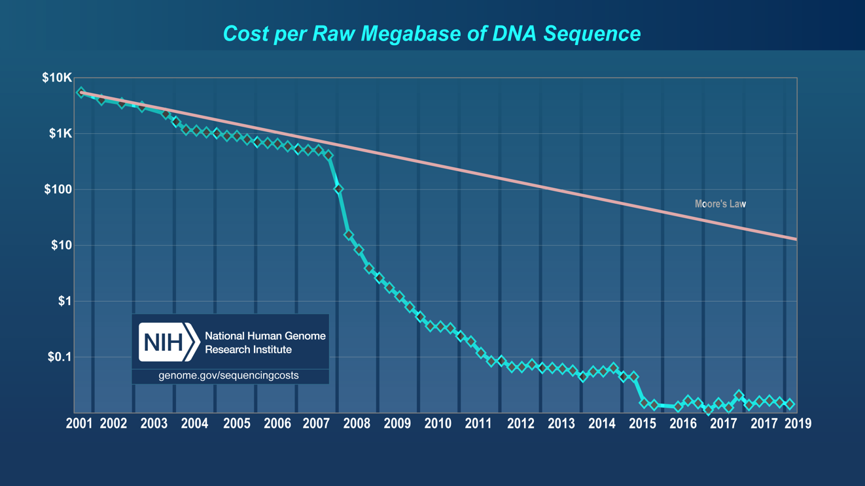

Slide 6


Slide 7
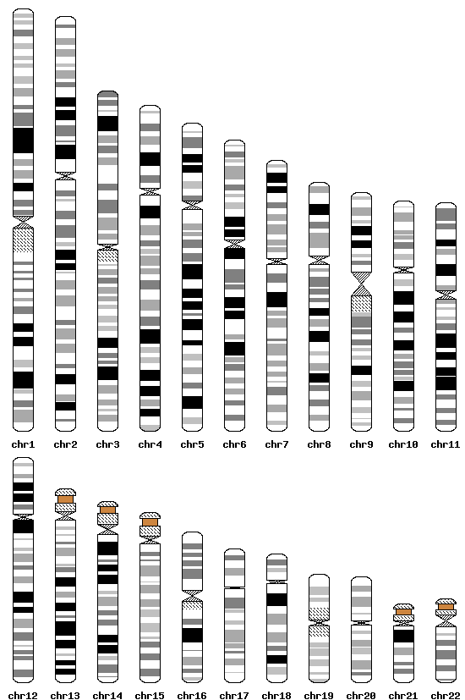
Reads < Contigs < Genome
<
<

Slide 8
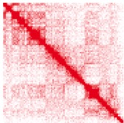
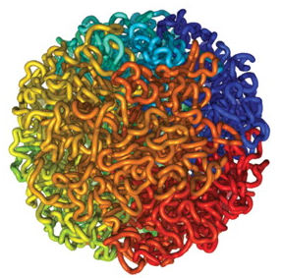
Proximity Ligation (Hi-C) captures the 3D structure of chromosomes
9
8
7
6
coordinate
5
4
3
2
1
Lieberman-Aiden, et. al. Science, 2009
1
2
3
4
5
6
7
8
9
coordinate

Slide 9
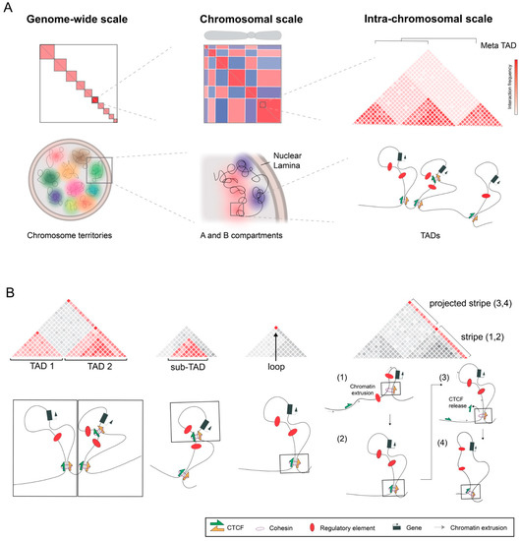
Irene Mota-Gómez and Darío G. Lupiáñez; Genes 2019, 10(6), 415.

Slide 10
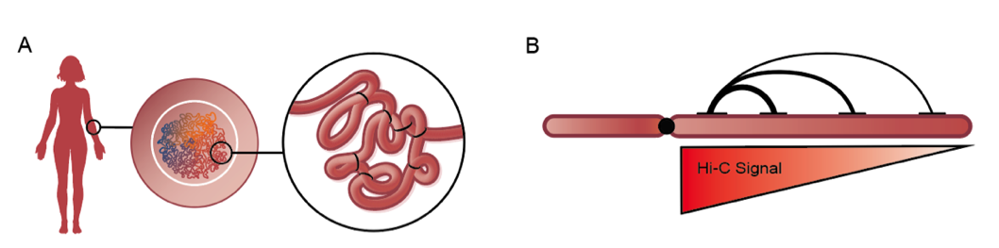
Proximity Ligation captures ultra-long genomic contiguity
Proximity in 3D is correlated with genomic distance
Can be used to:
Scaffold and phase a genome of any size
Find rearrangements

Slide 11
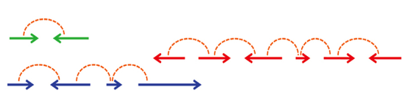
Using Hi-C to assemble chromosome-scale genome scaffolds
Proximity-Guided Assembly™ :
Clustering contigs into chromosome groups
Ordering and orienting the contigs in scaffolds
Burton, et al. Nature Biotech, 2013

Slide 12
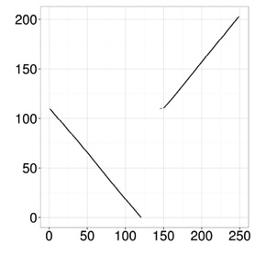
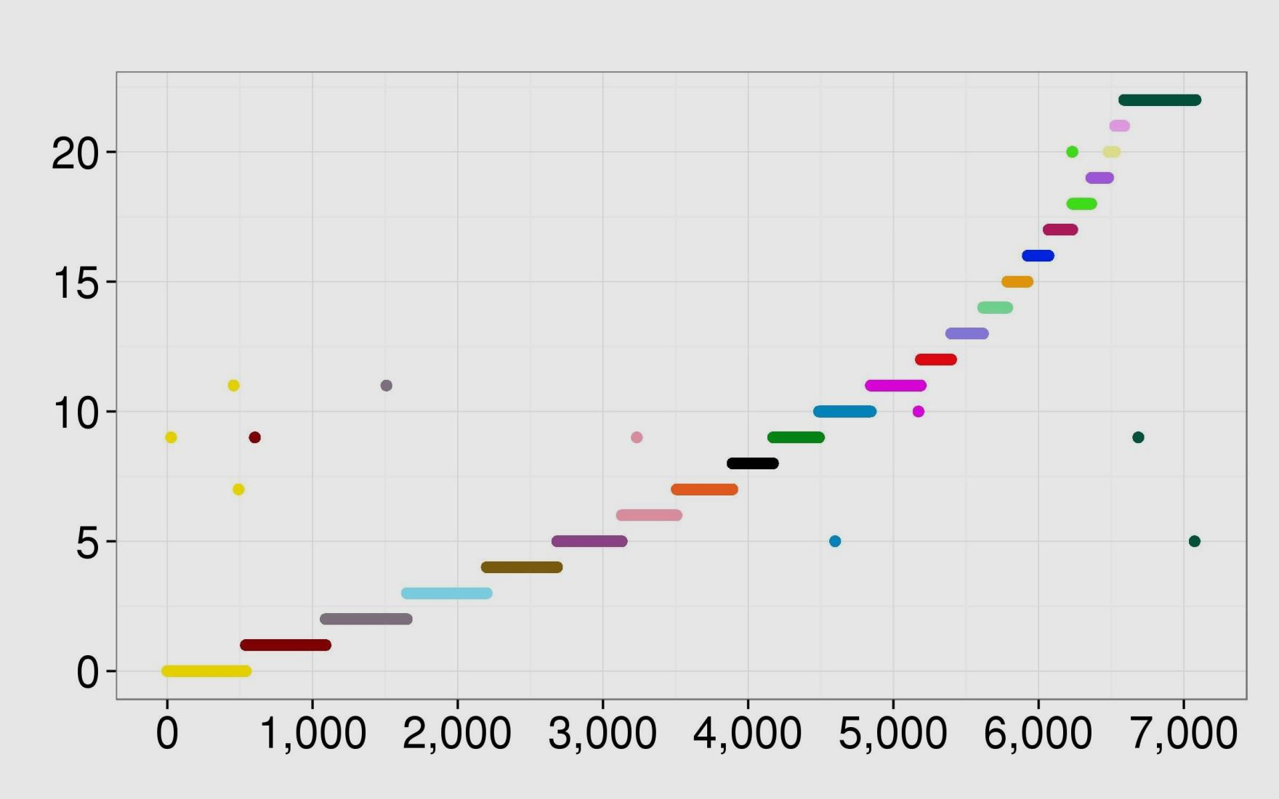
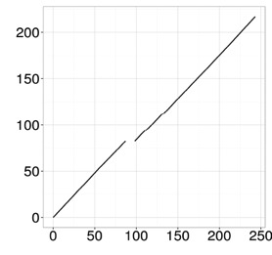
Assembling the human genome using Hi-C
580 contigs in chr1 cluster
Lachesis ordering (Mb)
chr1
Cluster derived by Lachesis
True position on chr1 (Mb)
585 contigs in chr2 cluster
chr2
Lachesis ordering (Mb)
Contigs ≥90 kb in the human de novo assembly
>99.8% of contigs clustered correctly
>97% of contigs ordered correctly
True position on chr2 (Mb)
Burton JN et al, Nature Biotech 31:1119 (2013)

Slide 13
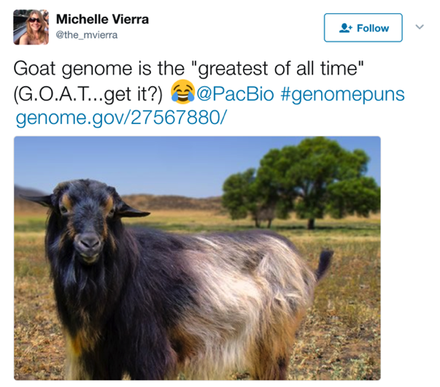
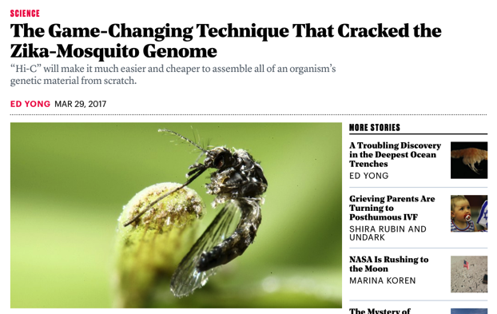
Hi-C becomes a routine tool in eukaryotic
genome assembly
Human (Burton et al. 2013 Nature Biotech)
Goat (Bickhart et al. 2017 Nature Genetics)
Stickleback (Peichel et al. 2017 Heredity)
Amaranth (Lightfoot et al. 2017 BMC Biology)
Firefly (Fallon et al. 2017 BioRxiv)
Black raspberry (Jibran et al. 2018 Hort. Res.)
Clownfish (Lehmann et al. 2018 BioRxiv)
Sugar beet (Funk et al. 2018 Plant J)
Malaria Mosquito (Ghurye et al. 2018 BioRxiv)
Cannabis (McKernan et al. 2018 OSF)
Cannabis (Grassa et al. 2018 BioRxiv)
E. festucae (Winter et al. 2018 PLoS Genetics)
Honeybee (Wallberg et al. 2018 BioRxiv)
Aphid (Chen et al. 2018 BioRxiv)
T. inflatum (Olarte, et al. 2019 BMC Genomics)
Bee mites (Techer et al. 2019 BioRxiv)
…more from other labs…

Slide 14
Time To Get Into It

Slide 15
Hands-On
Basic Scaffolding Steps
Generate contigs/intermediate scaffolds
Align Hi-C data
QC Hi-C data
(optional) Phase contigs with Hi-C
Scaffold with Hi-C (one phase at a time)
Correct scaffolds (one phase at a time)
(optional) Re-phase scaffolds with Hi-C

Slide 16
Hands-On
Basic Scaffolding Steps
Generate contigs/intermediate scaffolds
Align Hi-C data
QC Hi-C data
(optional) Phase contigs with Hi-C
Scaffold with Hi-C (one phase at a time)
Correct scaffolds (one phase at a time)
(optional) Re-phase scaffolds with Hi-C

Slide 17
Hands-On
2. Align Hi-C data
Install:
BWA: module load bwa/0.7.17
SAMtools: module load samtools
samblaster: module load samblaster
Follow steps at https://phasegenomics.github.io/2019/09/19/hic-alignment-and-qc.html
FASTA is already indexed (bwtsw)
Use 16 CPUs in BWA-MEM (allocate that many in SLURM, 16GB RAM and 2-hour time limit)
Write BAM to your home directory (or another easy to access location)
Data: /share/workshop/genome_assembly/phase_genomics_2020_data_fungus/

Slide 18
More Theory While We Wait

Slide 19
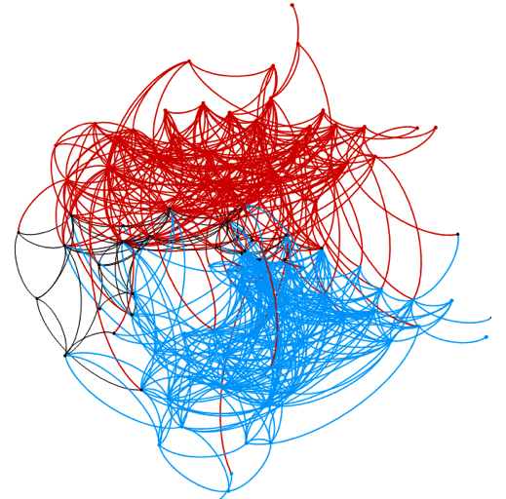
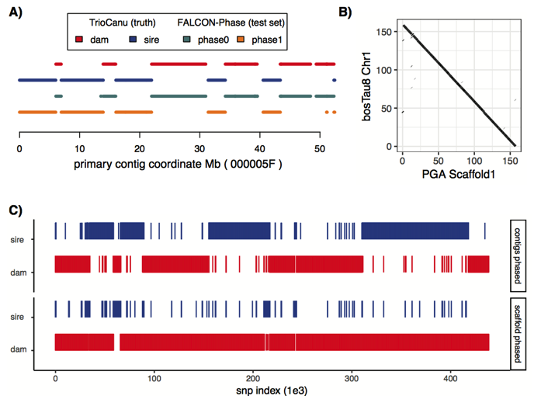

FALCON-Phase: Combining SMRT and Hi-C data to generate fully phased genome assemblies.
Kronenberg, et. al., BioRxiv 2018; In collaboration with Sarah Kingan, Pacific Biosciences

Slide 20
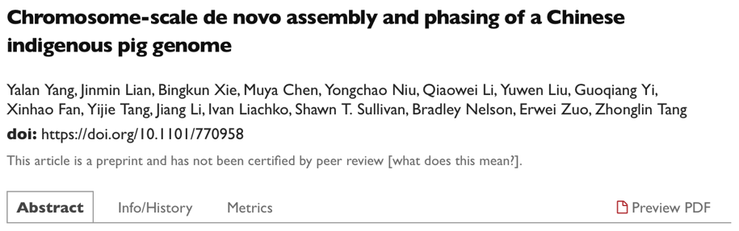
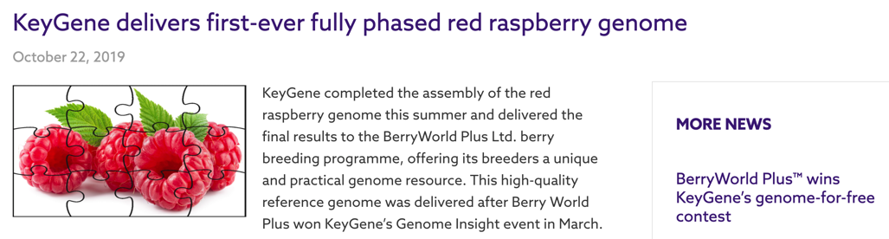


Slide 21

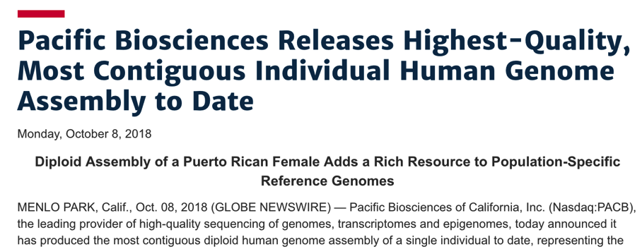
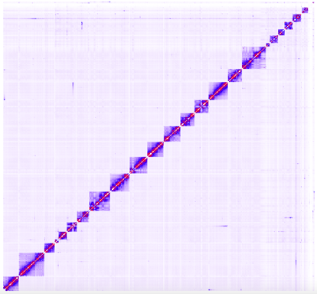
Assembling the highest quality and contiguity human genome to date

Slide 22
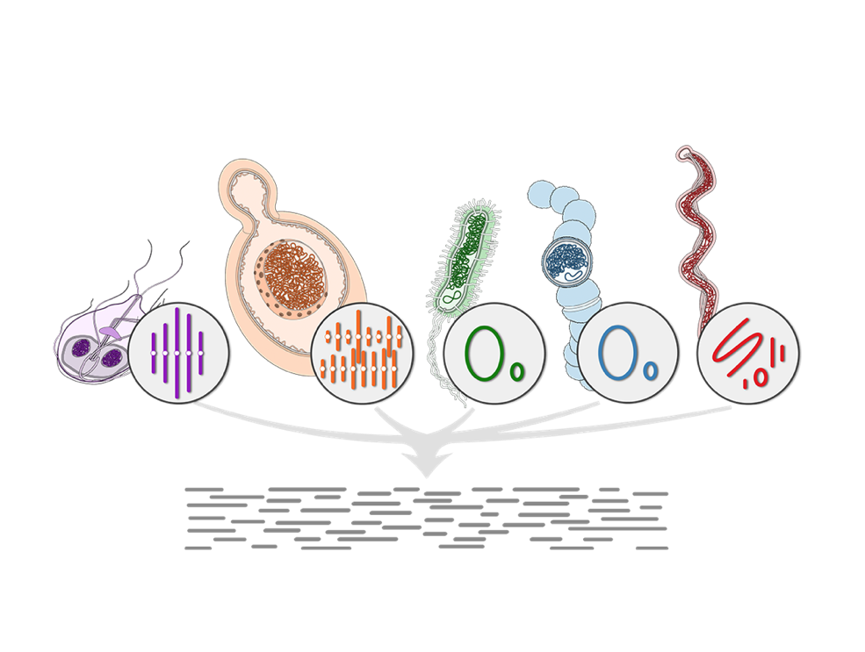
The problem with shotgun metagenomics
Cannot tell which sequences belong to which organism
Binning methods are inaccurate, hard to reproduce
No way to track plasmids / viruses / antibiotic resistance
Missing lots of organisms that are not in databases

Slide 23
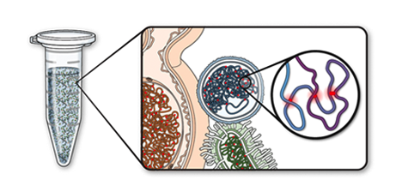
Any sequences that interact by Proximity must have originated from the same cell

Slide 24
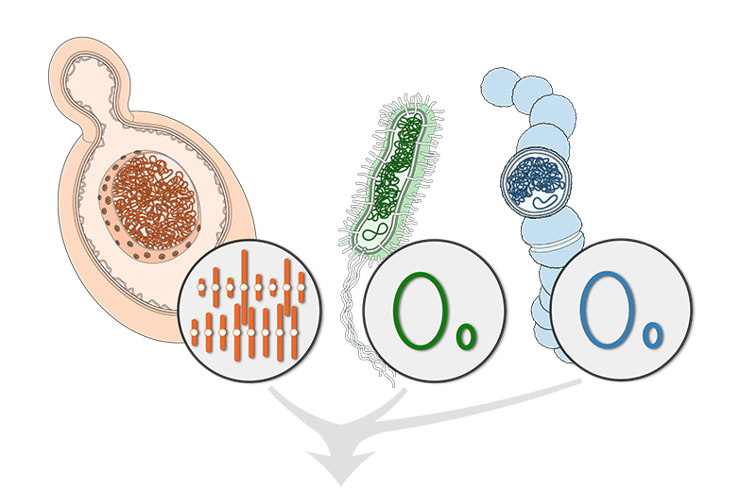

Shotgun sequencing

Slide 25
Proximity ligation chemically links DNA inside the same cells
Connects metagenome sequences

Slide 26
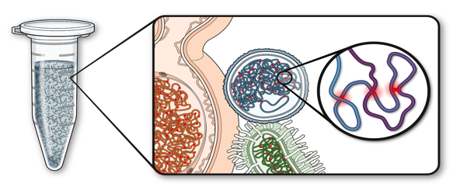
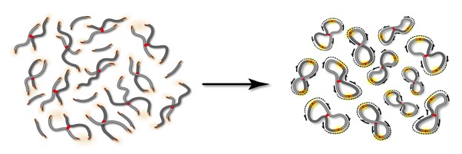
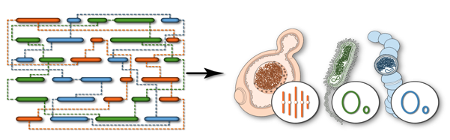
Proximity-Guided Metagenome Assembly (ProxiMeta™)
Crosslink intact cells to capture intra-cellular interactions
Isolate and sequence crosslinked junctions
Use proximity connections to deconvolute metagenome

Slide 27
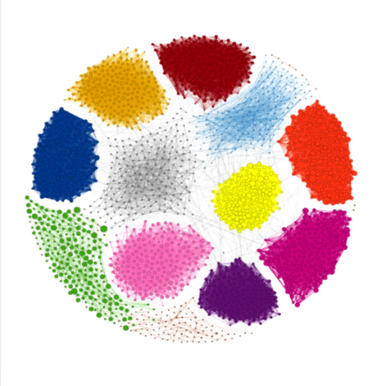
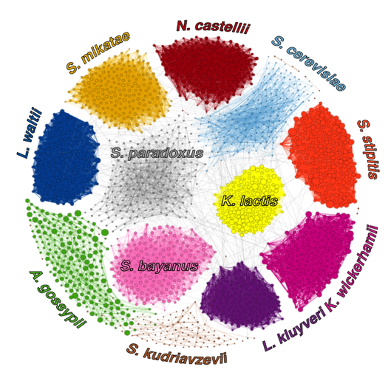
Reference-quality pro- and eu- karyotic genomes from mixed populations
Draft assembly:
Size = 135.2 Mbp
Contig N50 = 17.3 Kb
Error rate <1%
Burton JN, Liachko I et al, G3 (2014)

Slide 28

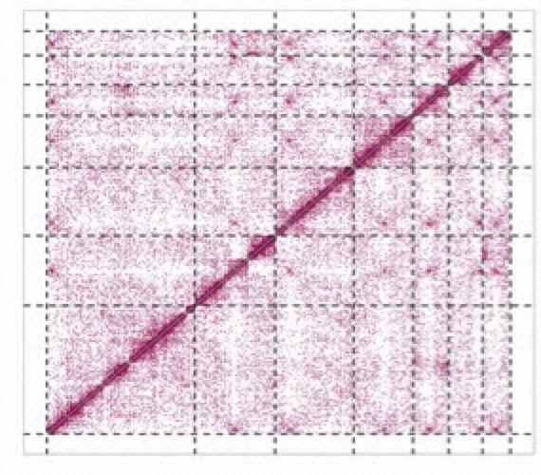
Reference-quality pro- and eu- karyotic genomes from mixed populations
Burton JN, Liachko I et al, G3 (2014)

Slide 29
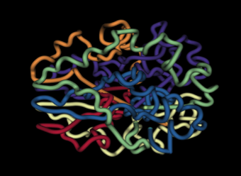
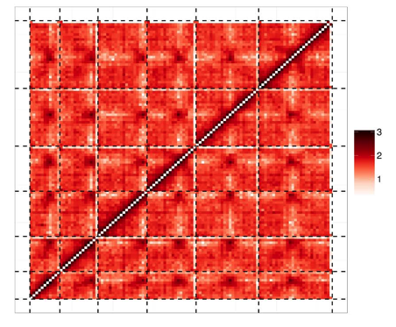
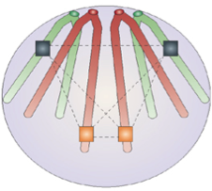
3D modeling of genomes directly from mixed populations
Kluyveromyces lactis
Nelle Varoquaux
Barzel and Kupiec, 2008
*Dark spots in the middle of each chromosome are centromeric regions.

Slide 30
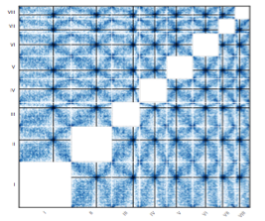
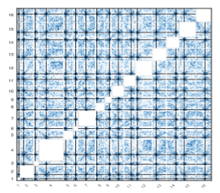
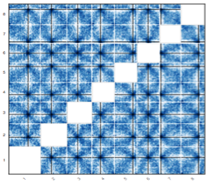
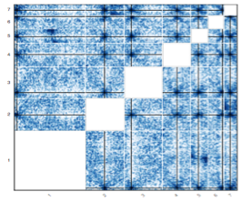
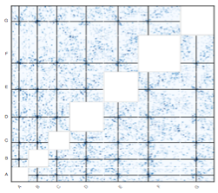
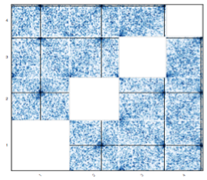
S.stipitis
S.paradoxus
L.waltii
K.lactis
K.wickerhamii
A.gossypii
P.pastoris
S.uvarum
Z.rouxii
Sz. pombe
L.kluyveri
L.thermotolerans
Varoquax et al., NAR, 2015

Slide 31
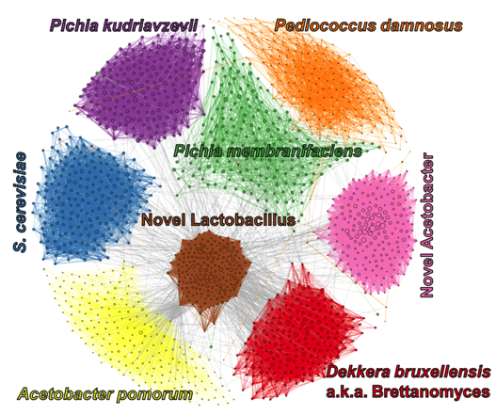
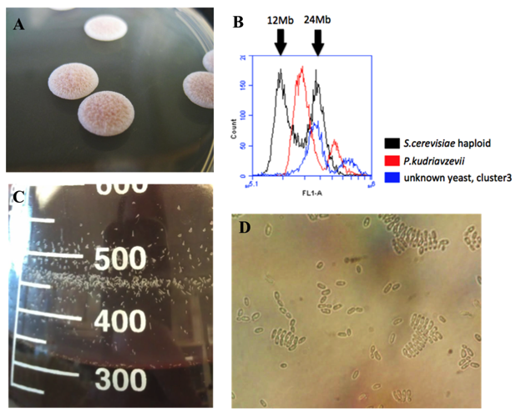
Assembly of a hybrid yeast from a beer metagenome
Heil, Burton, Liachko, et al., Yeast, 2017

Slide 32
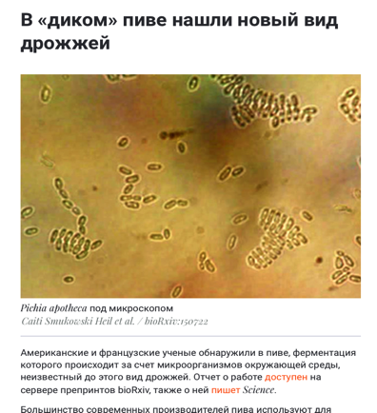
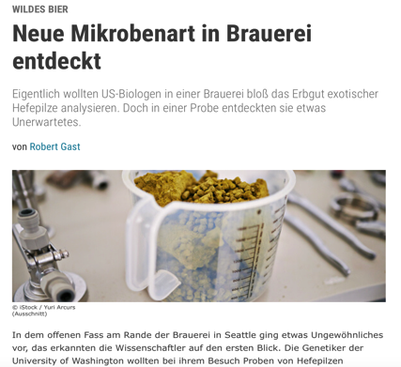
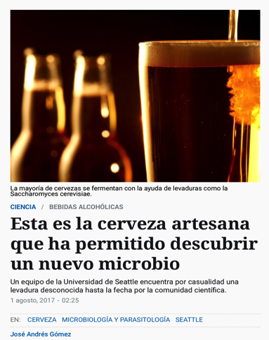
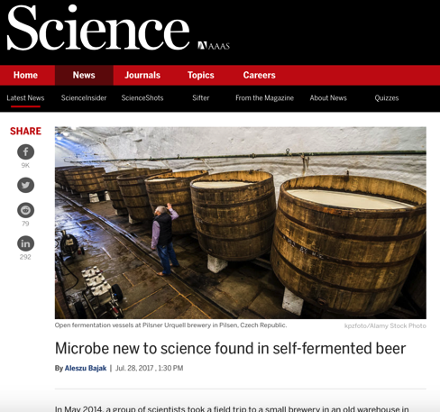
Assembly of a hybrid yeast from a beer metagenome
Heil, Burton, Liachko, et al., Yeast, 2017

Slide 33
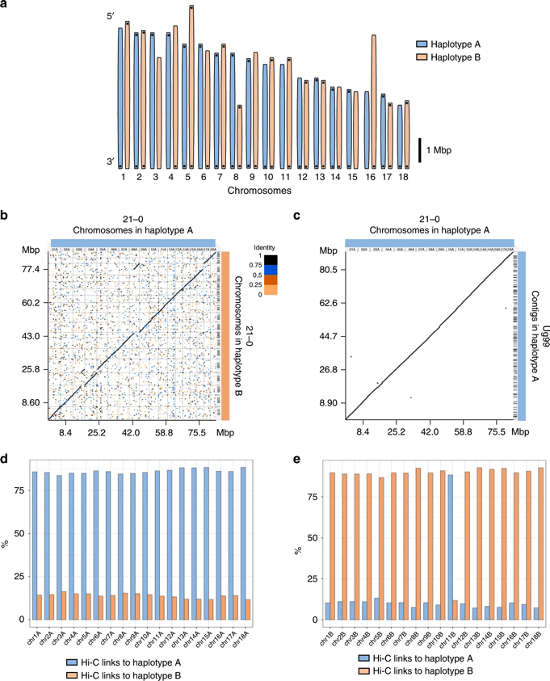
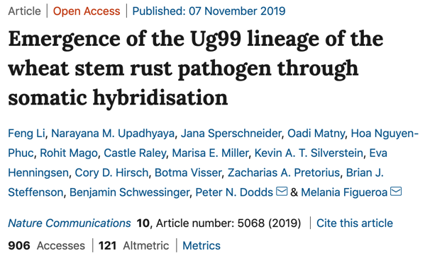
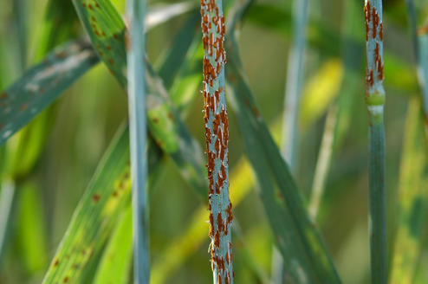
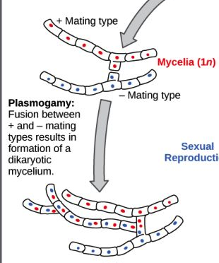

Slide 34
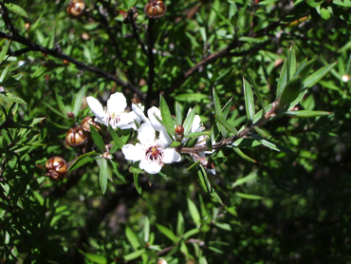
Scaffolding a contaminated plant sample
(plant genome assembly contains >35% fungal/bacterial contigs)
Metric | Original Assembly | +Proximo
Scaffolds | 12,787 | 11
N50 | 3.8 kb | 26.3 Mb
N90 | 1.0 kb | 20.7 Mb
Scaffolded Length | 471 Mb | 295 Mb
% Scaffolded (len) | N/A | 62.8 %
% Plantlike (len) | N/A | 99.3 %
Fungal contigs in assembly | 1471 | 4
Bacterial contigs in assembly | 1582 | 0
With David Chagne (Plant & Food Research , NZ)

Slide 35
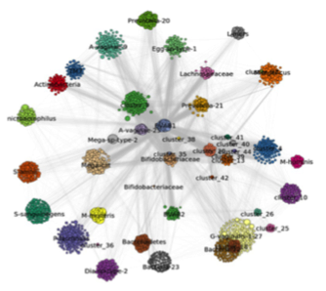
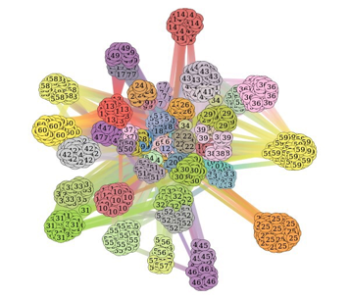
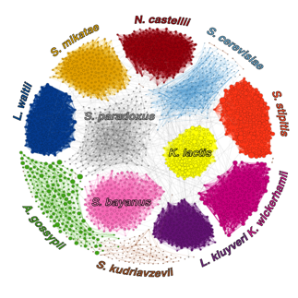

Reference-quality genomes from mixed populations

Slide 36


High numbers of high-quality, novel genomes directly from rumen samples
Completeness
Novelty
Contamination
In collaboration with Titus Brown, Herminia Loza-Tavera
Stewart et al., Nature Communications, 2018

Slide 37




High numbers of high-quality, novel genomes directly from rumen samples
In collaboration with Titus Brown, Herminia Loza-Tavera
Stewart et al., Nature Communications, 2018

Slide 38

Sequencing Lil Bub’s magical poop
With Holly Ganz, Jennifer Gardy

Slide 39


Sequencing Lil Bub’s magical poop
With Holly Ganz, Jennifer Gardy

Slide 40


Plasmids/viruses are key players in the microbiome
Plasmids/Phage transmit AMR (Anti-microbial resistance)
Plasmids often transmit pathogenic/toxic genes (ex. Anthrax)
Virtually impossible to connect AMR and mobile elements with host strains using normal NGS
Need a method that can directly link plasmids/viruses to hosts.
Furuya and Lowy, Nat Rev Micro 2006
Luna et. al., J Clin Microbiol. 2006 Jul; 44(7): 2367–2377

Slide 41


Highly complex wastewater community
GENOMES
AMR GENES
PLASMIDS
Stalder et al., 2019, ISME J

Slide 42

Linking the ‘Mobilome’ to the Microbiome
Genomes
Plasmids
Antibiotic resistance genes
Proteobacteria
Stalder et al., 2019, ISME J

Slide 43


~1200 PAGs
396 host-ARG assn
83 plasmid-host assn
58 integron-host assn
Bacterioidetes
Firmicutes
Stalder et al., 2019, ISME J

Slide 44


Combining long reads and ProxiMeta in a complex microbiome context
Bickhart et al., Genome Biology, 2019

Slide 45


Connecting ARGs and viruses to their hosts
*188 Novel viruses and host interactions discovered from one rumen sample
Bickhart et al., Genome Biology, 2019

Slide 46

Proximity-Guided Metagenome Assembly
Genomes, Strains, Mobile Elements
No culturing
No binning/de-replication
No a priori information
No HMW-DNA
No special machinery

Slide 47
Using Hi-C Data

Slide 48
Using Hi-C Data
If you take away nothing else…
Hi-C data measure the frequency of physical interaction among loci

Slide 49
Using Hi-C Data
Hi-C data are usually represented as a matrix
=

Slide 50
Using Hi-C Data
Alignment is used to turn Hi-C data into a matrix
Hi-C reads are paired ends: each pair (typically) maps to loci that were physically close but not necessarily genetically close
Aligning Hi-C reads to a reference genome counts the number of times loci were physically close
Think of a Hi-C library as a mate pair library whose insert sizes are infinite, drawn from a probability distribution

Slide 51
Using Hi-C Data
Hi-C matrixes must be normalized
Normalize for “contig size” (actually restriction site distribution) to transform to frequency
Normalize for other factors depending on problem
Coverage
Could mean variation in copy number, abundance, something else

Slide 52
Using Hi-C Data
Once you have a matrix, do linear algebra, graph theory, machine learning, etc.
Principle component analysis
Clustering
Community detection
Max flow/min cut
Markov chain Monte Carlo (MCMC)
Deep learning
Custom algorithms

Slide 53
Tools for Hi-C

Slide 54
Tools for Hi-C
Basic Scaffolding Steps
Generate contigs/intermediate scaffolds
Align Hi-C data
QC Hi-C data
(optional) Phase contigs with Hi-C
Scaffold with Hi-C (one phase at a time)
Correct scaffolds (one phase at a time)
(optional) Re-phase scaffolds with Hi-C

Slide 55
Tools for Hi-C
1. Generate contigs/intermediate scaffolds
Sure, one slide can handle this
Illumina, PacBio, Nanopore, 10X, BioNano, and more all have roles

Slide 56
Tools for Hi-C
2. Aligning Hi-C data
BWA-MEM is the standard, with -5SP options
In SAMtools, filter read/mate unmapped, not-primary, and secondary alignments (-F 2316)
Helpful to flag PCR dupes (samblaster is fine, Picard if you want)
Recommended workflow: https://phasegenomics.github.io/2019/09/19/hic-alignment-and-qc.html

Slide 57
Tools for Hi-C
3. QC’ing Hi-C data
Several options, all based on trying to detect dependable Hi-C data (e.g., split reads, align to different contigs, align far apart)
HiCUP
HiC-Pro
Juicer
hic_qc
Etc.
Recommended workflow: https://phasegenomics.github.io/2019/09/19/hic-alignment-and-qc.html

Slide 58
Tools for Hi-C
4. Phasing contigs with Hi-C data
FALCON-Phase
Tool + recommended workflow: https://github.com/phasegenomics/FALCON-Phase

Slide 59
Tools for Hi-C
5. Scaffold with Hi-C
Best open source tools:
3d-dna (Juicer ecosystem from the Aiden lab)
SALSA (from the makers of Canu)
Commercial options
Proximo (Phase Genomics)
HiRise (Dovetail)

Slide 60
Tools for Hi-C
6. Correct scaffolds
The actual key to Hi-C scaffolding – no scaffolder does a perfect job all the time
Best of breed: Juicebox (Aiden lab)

Slide 61
Tools for Hi-C
6. Correct scaffolds
The actual key to Hi-C scaffolding – no scaffolder does a perfect job all the time
Best of breed: Juicebox (Aiden lab) https://github.com/aidenlab/Juicebox
Helpful auxiliary tools: https://github.com/phasegenomics/juicebox_scripts

Slide 62
Tools for Hi-C
7. Re-phase scaffolds with Hi-C
If you’re phasing, run a second FALCON-Phase pass over the scaffolds to detect and correct phasing issues which may have been murky at the contig stage but are now clear in scaffolds

Slide 63

Hands-On
6. Correct scaffolds
You’ll see stuff like this – correct the contigs too where needed

Slide 64
Juicebox Demo

Slide 65
Time To Get Back Into It

Slide 66
Hands-On
Basic Scaffolding Steps
Generate contigs/intermediate scaffolds
Align Hi-C data
QC Hi-C data
(optional) Phase contigs with Hi-C
Scaffold with Hi-C (one phase at a time)
Correct scaffolds (one phase at a time)
(optional) Re-phase scaffolds with Hi-C

Slide 67
Hands-On
Basic Scaffolding Steps
Generate contigs/intermediate scaffolds
Align Hi-C data
QC Hi-C data
(optional) Phase contigs with Hi-C
Scaffold with Hi-C (one phase at a time)
Correct scaffolds (one phase at a time)
(optional) Re-phase scaffolds with Hi-C

Slide 68
Hands-On
3. QC Hi-C data
Install: module load hic_qc
Enter environment: source activate hic_qc-1.0
Follow steps at https://phasegenomics.github.io/2019/09/19/hic-alignment-and-qc.html
Use the alignments you generated in the previous step

Slide 69

Hands-On
3. QC Hi-C data
Let’s talk about the report

Slide 70
Hands-On
6. Correct scaffolds
Install Juicebox: https://github.com/aidenlab/Juicebox/wiki/Download
Load .hic and .assembly files from /share/workshop/genome_assembly/phase_genomics_2020_data_fungus/
Fix scaffold issues
Export new .assembly file
Use juicebox_assembly_converter.py to generate a new FASTA, AGP, BED, and break report for your genome edits
Install: module load juicebox_scripts
Need to run with python /software/juicebox_scripts/1487f3/lssc0-linux/bin/juicebox_assembly_converter.py
Use which juicebox_assembly_converter.py if you can’t find it

Slide 71








Acknowledgements
Collaborators
Eva Top
Mick Watson
Patrick Chain
Herminia Loza-Tavera
Tim Smith
Adam Phillippy
Justin Sonnenburg
Team PacBio
Phase Genomics
Ivan Liachko
Andrew Wiser
Max Press
Zev Kronenberg
Kyle Langford
Kaylee Mueller
Kayla Young
Gherman Uritskiy
UW Genome Sciences
Jay Shendure
Maitreya Dunham
Ehanan Borenstein
Josh Burton
Bill Noble
Nelle Varoquaux
Ferhat Ay

